Slide 1
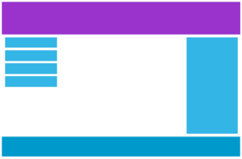


Responsive Web Design(RWD)
Responsive Web Design(RWD) makes your web page look good on all devices.
Designing For The Best Experience For All Users
Responsive web design is not a program or a JavaScript.
Web pages can be viewed using many different devices: desktops, tablets, and phones. Your web page should look good, and be easy to use, regardless of the device.
Web pages should not leave out information to fit smaller devices, but rather adapt its content to fit any device
Desktop
Tablet
Phone

Slide 2
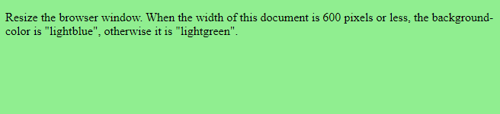
Responsive Web Design - Media Queries
Media query is a CSS3 technique uses the @media rule to include a block of CSS properties only if a certain condition is true.
Ex. Given below sets the background color of the body to light blue when the screen width is 600 pixels or less
@media only screen and (max-width: 300px) {
body {
/* for mobile screen */
background-color: lightblue;
}
<body>
<p>Resize the browser window. When the width of this document is 600 pixels or less, the background-color is "lightblue", otherwise it is "lightgreen".</p>
</body>
</html>
Media Queries – changind BG COLOR
<html> <head>
<style>
body { /* for desktop screen */
background-color: lightgreen;
}
@media only screen and (max-width: 600px) {
body {
/* for tablet screen *?
background-color: lightblue;
}
}
</style>
</head>

Slide 3

Media Queries - Variable Font Size.
We can also use media queries to change the font size of an element on different screen sizes
</head>
<body>
<div>Example DIV.</div>
</body>
</html>
<html>
<head>
<style>
div{
background-color: lightgrey;
padding: 20px;
}
@media screen and (min-width: 600px) {
div{
font-size: 80px;
}
}
@media screen and (max-width: 600px) {
div{
font-size: 25px;
}
}
</style>

Slide 4
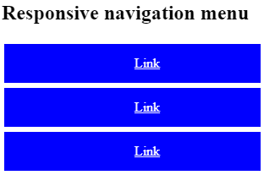
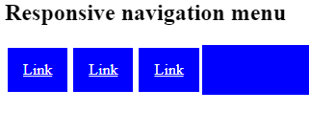
Media Queries For Menus
Media queries to create a responsive navigation menu, that varies in design on different screen sizes.
/* On screens that are 600px wide or less, make the menu links stack on top of each other instead of next to each other */
@media screen and (max-width: 600px) {
.topnav a {
float: none; width: 100%;
} }
</style> </head> <body> <h2>Responsive navigation menu</h2>
<div class="topnav">
<a href="#">Link</a> <a href="#">Link</a>
<a href="#">Link</a> </div> </body>
</html>
<html>
<head>
<style>
/* Style the top navigation bar */
.topnav {
overflow: hidden;
background-color:blue;
}
/* Style the topnav links */
.topnav a {
float: left; display: block;
color: white; text-align: center;
padding: 14px 16px; border-style: solid;
}
/* Change color on hover */
.topnav a:hover {
background-color: #ddd;
color: black;
}

Slide 5
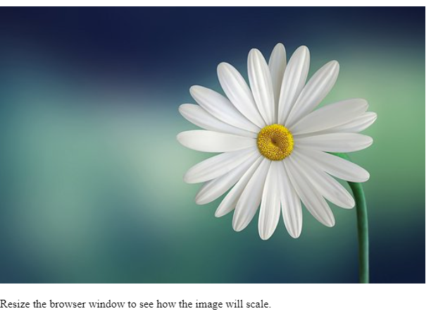
Responsive Web Design - Images
Using The width Property
If the width property is set to a percentage and the height property is set to "auto", the image will be responsive and scale up and down
<html>
<head>
<style>
img{
width: 100%;
height: auto;
}
</style>
</head>
<body>
<img src="flower1.jpg" width="460" height="345">
<p>Resize the browser window to see how the image will scale.</p>
</body>
</html>

Slide 6
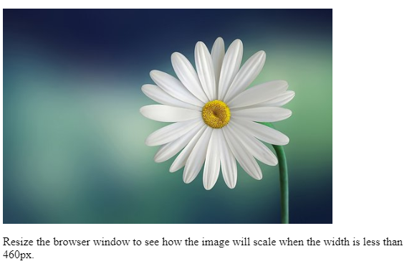
Responsive Web Design - Images
max-width Property
If the max-width property is set to 100%, the image will scale down if it has to, but never scale up to be larger than its original size:
<html>
<head>
<style>
img {
max-width: 100%;
height: auto;
}
</style>
</head>
<body>
<img src="flower1.jpg" width="460" height="345">
<p>Resize the browser window to see how the image will scale when the width is less than 460px.</p>
</body>
</html>

Slide 7
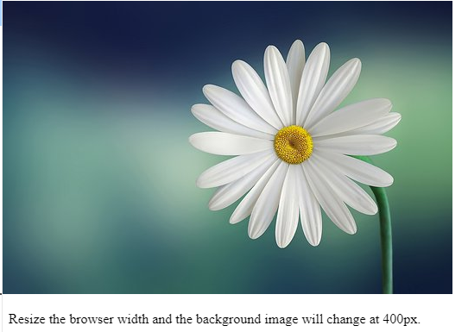
Responsive Web Design - Images
Different Images for Different Devices
media queries used to display different images on different devices.
Here is one large image and one smaller image that will be displayed on different devices:
<html>
<head>
<style>
/* For width smaller than 400px: */
body{
background-repeat: no-repeat;
background-image: url('img_smallflower.jpg');
} /* For width 400px and larger: */
@media only screen and (min-width: 400px) {
body {
background-image: url("flower1.jpg");
}
}
</style>
</head>
<body> <p style="margin-top:360px;">Resize the browser width and the background image will change at 400px.</p> </body></html>

Slide 8
How to Set the width-range for a Media Query
The method we just discussed of creating media queries by applying just one width property solves just one problem
<html>
<head>
<title>Example Media Query</title>
<style>
/* styles for all screens */
.image {
width: 100%;
height: auto;
} /* styles for screens with a maximum width of 768px */
@media screen and (max-width: 768px) {
.image {
max-width: 100%;
}
}
</style>
</head>
<body>
<img src="flower1.jpg" alt="Example Image" class="image">
</body>
</html>

Slide 9
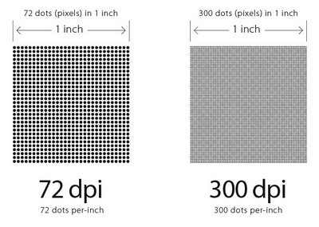
Dots Per Inch (DPI)
dpi
Represents the number of dots per inch.
Screens typically contains 72 or 96 dots per inch, but the dpi for printed documents is usually much greater.
<html>
<head>
<title>Image DPI Example</title>
<style>
img {
width: 400px;
height: 300px;
dpi:300;
}
</style>
</head>
<body>
<h1>Image DPI Example</h1>
<p>This image will have a DPI of 300:</p>
<img src="flower1.jpg" alt="A beautiful image">
</body>
</html>

Slide 10
“and” Operator
When using media queries, we can use logical operators such as “and" to combine multiple conditions
<html>
<head>
<style>
/* Styles for all devices */
body {
font-size: 16px;
}
/* Styles for devices with screens between 768px and 1024px wide */
@media (min-width: 768px) and (max-width: 1024px) {
body {
font-size: 20px;
}
}
</style>
</head>
<body>
<p>Welcome to my responsive web page!</p>
</body> </html>

Slide 11
Media Queries - Comma-separated lists
<html>
<head>
<style>
/* Default styles for all heading elements */
h1, h2, h3, h4, h5, h6 {
font-family: sans-serif;
font-weight: bold;
}
/* Styles heading elements on small screens */
@media (max-width: 767px) {
h1, h2, h3, h4, h5, h6 {
font-size: 20px;
}
}
/* Styles for medium and large screens */
@media (min-width: 768px) {
h1, h2, h3, h4, h5, h6 {
font-size: 24px;
}
} </style>
Comma-separated lists can be useful in RWD to apply the same style rules to multiple selectors, but only under certain conditions.
For example, apply different styles to heading elements (h1, h2, h3, etc.) depending on the screen size.
</head>
<body>
<h1>Heading 1</h1>
<h2>Heading 2</h2>
<h3>Heading 3</h3>
<h4>Heading 4</h4>
<h5>Heading 5</h5>
<h6>Heading 6</h6>
</body>
</html>

Slide 12
Breakpoints
In CSS, breakpoints are used to apply different styles to a web page based on the screen size of the device.
The layout of the page changes to fit different screen sizes, making it more accessible and user-friendly.
/* Large devices (laptops/desktops, 992px and up) */
@media only screen and (min-width: 992px) {
.example {background: orange;}
} /* Extra large devices (large laptops and desktops, 1200px and up) */
@media only screen and (min-width: 1200px) {
.example {background: pink;}
}
</style> </head>
<body> <h2>Typical Breakpoints</h2>
<p class="example">Resize the browser window to see how the background color of this paragraph changes on different screen sizes.</p> </body>
</html>
<html> <head> <style>
.example {
padding: 20px;
color: white;
}
/* Extra small devices (phones, 600px and down) */
@media only screen and (max-width: 600px) {
.example {background: red;}
} /* Small devices (portrait tablets and large phones, 600px and up) */
@media only screen and (min-width: 600px) {
.example {background: green;}
} /* Medium devices (landscape tablets, 768px and up) */
@media only screen and (min-width: 768px) {
.example {background: blue;}
}

Slide 13
Breakpoints Sizing elements
In RWD, breakpoints are used to define different screen sizes at which the layout of a webpage will change.
Sizing elements in RWD often involves using breakpoints to set different sizes for different screen sizes.
For example, Adjusting the font size of a paragraph element (<p>) depending on the screen size.
/* Font size for <p> elements on medium and large screens */
@media (min-width: 768px) {
p {
font-size: 18px;
}
}
</style>
</head>
<body>
<p>Sizing elements in RWD often involves using breakpoints to set different sizes for different screen sizes.
</p>
</body>
</html>
<html> <head>
<style>
/* Default font size for all <p> elements */
p {
font-size: 16px;
}
/* Font size <p> elements on small screens */
@media (max-width: 767px) {
p {
font-size: 14px;
}
}

Slide 14
Sizing elements - Relative Measurements Em, Rem
In RWD design, em and rem are commonly used units for sizing elements relative to the font size of the parent element or the root element, respectively.
/* Font size for headings on medium and large screens */
@media (min-width: 768px) {
h1, h2, h3 {
font-size: 2.5rem; /* 40px */
}
}
</style>
</head>
<body>
<html>
<head>
<meta charset="utf-8">
<title>Responsive Font Sizes with em and rem</title>
<style>
/* Default font size for all elements */
body {
font-size: 16px;
}
/* Font size for headings on small screens */
@media (max-width: 767px) {
h1, h2, h3 {
font-size: 2em; /* 32px */
}
}
In CSS, the rem unit is only relative to the document's root element, while the em unit is only relative to the immediate parent of the targeted element

Slide 15
Percentages ( Height,Width, Padding , Margin) in RWD
Percentages are commonly used in RWD for sizing elements such as width, height, padding, and margin.
When used appropriately, percentages can allow these elements to adjust their size based on the size of the viewport or parent container, resulting in a more flexible and responsive design.
1) Width and height: → sets width or height of an element to a percentage value will make it relative to the size of its parent element.
Ex> setting the width of an image to 50% will make it take up half of the width of its parent element. Similarly, setting the height of a div to 75% will make it take up 75% of the height of its parent element.
2) Padding: → sets the padding of an element to a percentage value will make it relative to the width of the element itself.
For example, setting the padding of a div to 10% will make the padding area equal to 10% of the width of the div.
3) Margin: Sets the margin of an element to a percentage value will make it relative to the width of its parent element. For example, setting the margin of a div to 5% will create a margin equal to 5% of the width of its parent element.

Slide 16
Percentages ( Height,Width, Padding , Margin) in responsive web design
<html>
<head>
<meta charset="utf-8">
<title>Using Percentages for Sizing Elements in Responsive Web Design</title>
<style>
/* Set width of div to 50% its parent elnt */
div {
width: 50%;
border: 1px solid black;
}
/* Set the height of an image to 75% of its parent element */
img {
height: 75%;
border: 1px solid black;
} /* Set the padding of a div to 10% of its own width */
.box {
padding: 10%;
border: 1px solid black;
}
/* Set the margin of a div to 5% of its parent element */
.spacer {
margin: 5%;
height: 100px;
background-color: gray;
}
</style>
</head>
<body>
<div>
<img src=“flower1.jpg" alt="Placeholder image">
</div>
<div class="box">
<p>Percentages are commonly used in RWD for sizing elements such as width, height, padding, and margin.
</p>
</div>
<div class="spacer"></div>
</body>
</html>

Slide 17
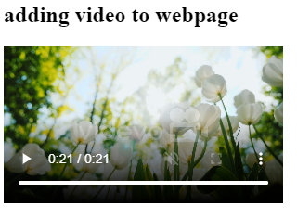
Responsive Web Design - Videos
To add a video in CSS RWD (Responsive Web Design), we can use <video> tag and then apply CSS styles to it to make it responsive
<html>
<head>
<meta charset="UTF-8">
<title>Video Example</title>
<style>
video {
width: 80%;
height: 60%;
}
</style>
</head>
<body>
<h2> adding video to webpage</h2>
<video controls>
<source src="flower.mp4" type="video/mp4">
</video>
</body>
</html>

Slide 18
Using The max-width Property
If the max-width property is set to 100%, the video player will scale down if it has to, but never scale up to be larger than its original size:
<html>
<head>
<meta name="viewport" content="width=device-width, initial-scale=1.0">
<style>
video {
max-width: 100%;
height: auto;
}
</style>
</head>
<body <video width="400px" controls>
<source src="flower.mp4" type="video/mp4">
</video> <p>Resize the browser window to see how the size of the video player will scale when the width is less than 400px.</p> </body>
</html>

